Slide 1
State of the project
in query-oriented summarization
Charles Sutton

Slide 2


Case of interest
Objective : find a subset of sentences summarizing the corpus according to the query and given a length constraint. The ideal output contains all the relevant information and is as short as possible.
INPUTS
OUTPUT
+ Query
Corpus
Model
Summary
Redundant information
Topic diversified
NLP
Deep learning
Maximum information
related to the query
Minimum redundancy
Sentences from the corpus only

Slide 3


Our framework
0.7
0.5
….
0.25
0.1
Neural
framework
Scored Sentences
Summary
in creation
+ Query
Embedding
Scoring
Summarizing
From Text to vectors
Doc2vec / Rnn
Query vs Documents
Applied at sentence-level
Maximizes query related information
Minimizes redundancy
Iterative
Greedy

Slide 4
Completion score : the key element
At sentence level
Between 0 and 1
Measures query relatedness taking into account the redundancy with sentences already in the summary
Problem : No training set of reference
What about wikipedia ?

Slide 5
Wikipedia as external source of data
Wide range of topics
Huge amount of data
Ability to acquire data through an API
Ability to simulate 4-uplets : (candidate sentence , query, partial summary, text)

Slide 6
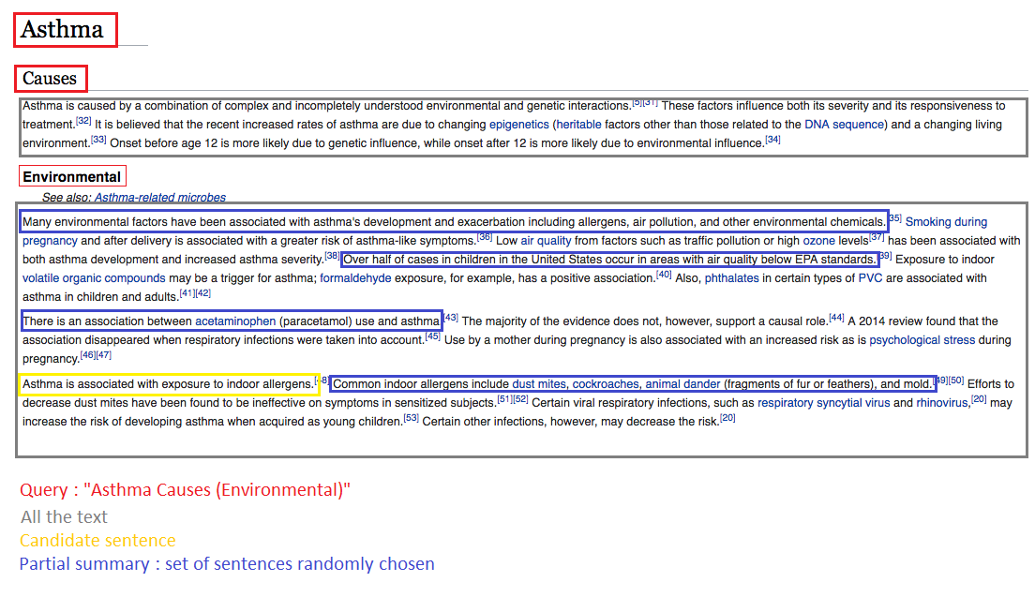

Slide 7
Training - data simulation and objective function
Text : Selection of random wikipedia article
Query : Selection of an arbitrary Section
Partial summary : Selection of randomly chosen a set of sentences
Candidate randomly chosen
inside the section → label 1
outside the section/article → label 0
Objective function : binary crossentropy

Slide 8
Summarizing procedure - A greedy approach
Initialization :
Empty summary
All the documents
At each iteration
Give a score to each sentence given, the corpus, the query, and the partial summary (empty at iteration 1)
Pick the sentence with highest score and insert it in the summary
Delete the selected sentence from documents to summarize
Conclusion
Outputs the summary, when the limit is reached

Slide 9
Related work and results
Mainly unsupervised / semi supervised approaches
Best “shallow” approach : Biased lexrank (2009)
A single deep approach, QODE (2012), hardly reproducible from the paper
Results ( Higher score means better model ) :
Evaluated against the TD-QFS dataset (Baumel et al, 2016)
Our model is trained with 4-uplet from wikipedia articles related to diseases
Embedder : LSTM language model trained on wikipedia data
Our Model has been trained during a short time, longer training may slightly improve results
 | ROUGE 2 | ROUGE SU 4
Biased lexrank | 0.17 | 0.2
Our Model | 0.106 | 0.135

Slide 10
Questions
How to improve the model ?
How can we take advantage of the ability to simulate data (reinforcement learning ?)
Is there a relevant architecture for our completion score network (currently fully connected layers)
Which data to simulate to improve performances faster ? (active learning)
Is binary cross entropy the most relevant objective function ?
Is this greedy approach the most relevant to create the summary ?
…
Is this project suitable to other tasks / applications ?
Question - answering
Information retrieval
Text comprehension
Sequence embedding
….

